Slide 1
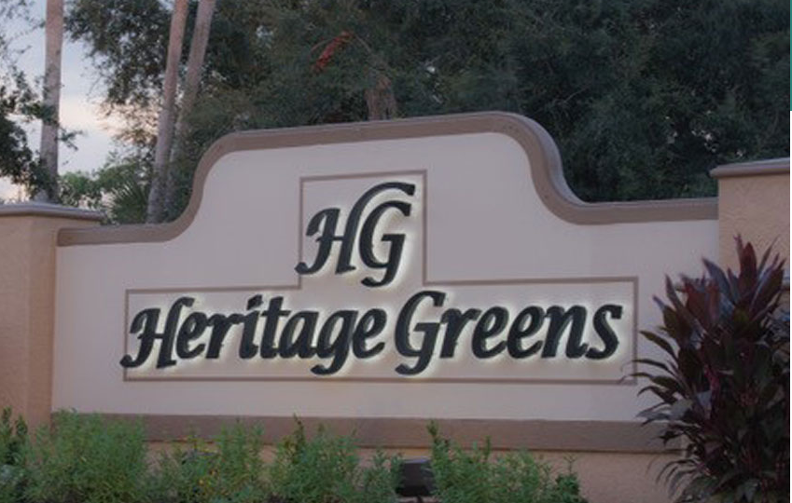
About Heritage Greens Community Association
Website: heritagegreensmaster.com
Management Company: Resort (239) 649-5526

Slide 2
Welcome to Heritage Greens
Located in North Naples, Heritage Greens is a semi-gated community surrounded by Arrowhead Golf Course. Homes include villa, coach home and single-family style living with beautiful views of lakes, natural preserve areas and the golf course.
Heritage Greens has a beautiful Community Center, with a fitness center, playground with a tot lot, outdoor heated pool, kiddie pool and spa. Surrounding the Community Center are 2 Tennis Courts, Basketball Courts and 2 lined Pickleball Courts. Within the community, there are two additional satellite pools - each heated with restroom facilities.
Our activities include: Water Aerobics, Mahjong, Book Club, monthly Bingo, Bunko, and Food Trucks, which are run by our Events Committee. Many of our residents are members of Naples Newcomers and Naples Sand Dollars.
Heritage Greens is located within 10-15 miles of some of Florida's most desired beaches. These include Vanderbilt Beach, Bonita Beach, Barefoot Beach, Clam Pass, Delnor-Wiggins State Park, and Lowdermilk Park.

Slide 3
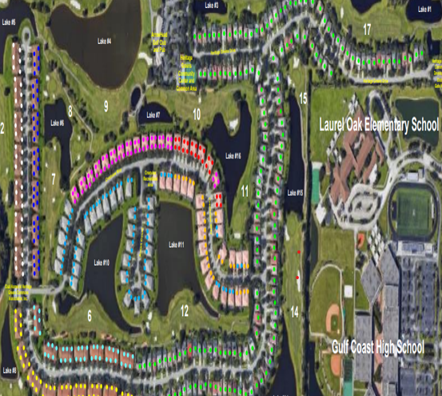
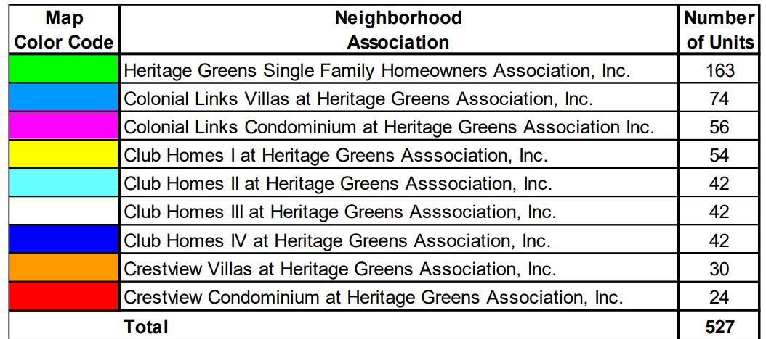
Heritage Greens Association Breakdown

Slide 5
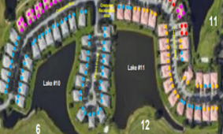

Slide 7
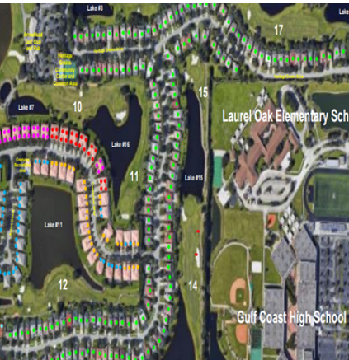

Slide 8
Website: heritagegreensmaster.com

Slide 9
Master Board of Directors
Linda Dye, PhD John Shelton Toni Malone
dyels624@gmail.com johnshelton4948@gmail.com temtationmom@aol.com
Cell: (973) 842-1720 Cell: (239) 248-4948 Cell: (201) 456-4623
Term: 3/28/2021- end Term: 4/13/2021- end Term: 9/20/2022 - end
of 1st Quarter 2023 of 1st Quarter 2023 of 1st Quarter 2023
Director at Large Director at Large Director, Voting Group 1
Mary McPartlin Bill O’Reilly, MBA
themarymcp@gmail.com weoreilly@gmail.com
Cell: (248) 762-4500 Cell: (239) 273-6750
Term 9/20/2022 – End of 1st Quarter 2024 Term: 9/20/22-End of 1st Quarter 2023
Director, Voting Group 4 Director at Large
Margaret Roman Bonnie Blaire
romanmk@farmingdale.edu gableslady@yahoo.com
Cell (516) 659-8328 Cell (786) 300-5758
Term: 9/20/2022 - End of 1st Quarter 2024 Term: 10/18/2022 – End of 1st Quarter 2024
Director, Voting Group 2 Director, Voting Group 3
HGCA Board Meetings: 4th Tuesday of every month at 6:00PM

Slide 10
Single Family Homes Board of Directors
President John Shelton johnshelton4948@gmail.com
Treasurer Andrew D'Antoni andydantoni@yahoo.com
Secretary *vacant
Property Management: Resort Management
Kevin Ingledue, LCAM kingledue@resortgroupinc.com
Meetings: 4th Wednesday of every month, at 1:00 PM, in the HG Community Center

Slide 11
Colonial Links Villas Board of Directors
President Vice President Treasurer
Nicole Conway Bill O’Reilly Bill Hollowsky mimi16nik@gmail.com weoreilly@gmail.com billhollowsky@yahoo.com
Secretary Director Director
Margaret Roman David Wesley *vacant jrdrmr@aol.com dgwes4@gmail.com
Property Management: Resort Management Kevin Ingledue, LCAM
kingledue@resortgroupinc.com
Meetings: 3rd Tuesday of the month, at 5:00 PM, at the HG Community Center
(Meetings cancelled June, July, August and September)

Slide 12
Crestview Villas Board of Directors
President
Suzanne Rivara srivara22@yahoo.com
Secretary
Deborah Howell dhowellmath@hotmail.com
Treasurer
Robert Topoleski rtopoleski@comcast.net
Director
Debbi Joos debbijoos@gmail.com
Property Management: Sandcastle
Rebecca O’Brien, CAM Rebeccao@sandcastlecm.com
Meetings: 3rd Thursday of the month, at 3:00 PM, in the HG Community Center

Slide 13
Colonial Links Condominiums Board of Directors
President Beatrix Stillwell Beatrix_b2@yahoo.com (239) 404-7921
Treasurer Theodore Staub tedstaub@fastmail.com
Member Richard Squillante Ricar43@aol.com
Member Michael Lillis 02653Mike@gmail.com
Member Mark Barnes mark.nplz@yahoo.com
Property Management: Resort Management
Kevin Ingledue, LCAM kingledue@resortgroupinc.com
Meetings: scheduled as needed

Slide 14
Crestview Condominiums Board of Directors
President David Tirado djt3229@comcast.net
Vice President Ronald Perry ronperry997@comcast.net
Secretary Deborah Lerra
Property Management: Resort Management
Joey Straface, CAM jstraface@resortgroupinc.com

Slide 15
Club Homes I Board of Directors
President / Treasurer
Michael Johnson mdsamash@gmail.com
Vice President
Dale Meszaros
Property Management: Ability (239) 591- 4200
Stacy Sanchez Stacy@abilityteam.com
Helen Ferrer Helen@abilityteam.com
Meetings: 3rd Tuesday of the month, at 4:00 PM.

Slide 16
Club Homes II Board of Directors
President/Treasurer Neil Cohen njjml3@yahoo.com
Vice President Christina Geiser chriselise19@yahoo.com
Secretary Elaine Beck
Director *vacant
Property Management: Sandcastle
Rebecca O'Brien, CAM rebeccao@sandcastlecm.com
Meetings: Every 3rd Thursday of the Month at 6:00 PM.
(cancelled for summer)

Slide 17
Club Homes III Board of Directors
President Ron Purvis Laam67@outlook.com
Vice President Fran MacPhail Jknfr90@gmail.com
Secretary George Coombs gfcoombs@gmail.com
Property Management: Sandcastle
Rebecca O'Brien, CAM rebeccao@sandcastlecm.com
Meetings: 3rd Wednesday of each month, at 3:30 PM, at the HG Community Center, unless otherwise posted.

Slide 18
Club Homes IV Board of Directors
President Bessie Jarjoura ggeobesd@yahoo,com
Vice President Anthony Benevenrok
Treasurer Gayle Smith
Secretary *vacant
Property Management: Sandcastle
Rebecca O'Brien, CAM rebeccao@sandcastlecm.com
Meetings: scheduled as needed

Slide 19
Community Development District (CDD)
The CDD provides the local governmental services and maintains the public infrastructure, except for the sewer and portable water system, which is maintained by Collier County.
John Shelton – Chair Barbara Pitts – Vice Chair
jshelton@heritagegreenscdd.com bpitts@heritagegreenscdd.com
Seat 4 Elected 4/2019 Seat 1 Elected 11/2016
Term Expires: 11/2024 Term Expires: 11/2022
Leigh Connor Dale Meszaros lconnor@heritagegreenscdd.com dmeszaros@heritagegreenscdd.com
Seat 2 Elected 11/2018 Seat 5 Elected 12/2008
Term Expires: 11/2024 Term Expires: 11/2022

Slide 20
Community Development District Meetings
The CDD meets the 3rd Monday of every month, in the HG Community Center, at 10:00 AM.
The CDD Management Company is Dorrill Management Group.
The Strand, 5672 Strand Court, Suite 1, Naples, 34110
www.dmgfl (239) 592-9115
Allie Coleman (alli@dmgfl.com) will be here the first Tuesday and the last Thursday, from 9 AM – 1 PM, in the Guardhouse for gate entrance requests.

Slide 21
Committees:
Architectural Review Board (ARB)
Andy D'Antoni - Acting Chairperson
Beatrix Stillwell David Pitts Gordon Brown
gordonbr@gmail.com
* Vacant Seat
** Forms available on The Heritage Greens Website
Appeals Committee
Dale Meszaros Brown Collins Kim Manning
dmesz15@hotmail.com
*Vacant Seat

Slide 22
Architectural Review Board (ARB) NO WORK CAN COMMENCE on your property without a fully approved ARB
An ARB application is needed when a material change will be made to alter the
exterior aesthetics or appearance of any property within Heritage Greens.
Before beginning any project including:
Roof replacement Landscape changes Driveway changes
Painting of Garage Door, Trim, Front Door, or House
Addition of any Structures Removal of trees or planting of trees
Obtain an ARB form from the Heritage Greens website, or at the HG Community
Center, in the hallway, adjacent to the Restrooms. Complete the form with supporting
documentation and submit to your sub-association AR approver. Your AR submission will be reviewed within 14-30 days.

Slide 23
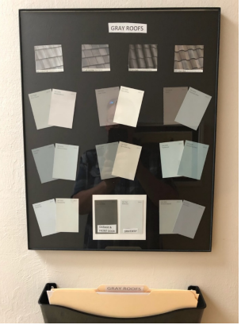
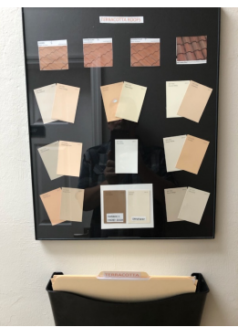
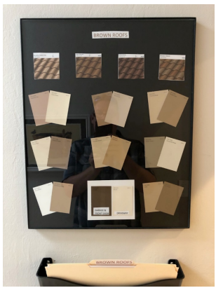
Three Color Palettes
Terra Cotta Roof Brown Roof Gray Roof

Slide 24
Landscape Committee
Suzanne Rivara Debbie Lerra Fran MacPhail
Events Committee
Ruth Bergmann – Chair HGEVENTSRSVP@gmail.com
Barbara Vitucci Jenny Latino Dee Potenza

Slide 25
Waste Management Collections: Tuesdays: Regular garbage, recycles, cardboard, and large items Fridays: Regular garbage Yard debris must be put in biodegradable bags. DO NOT put debris in the storm drains or in the street. This will lead to flooding in heavy rains.

Slide 26
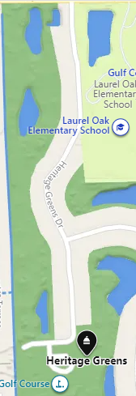
Heritage Greens Community Center
Located at 2215 Heritage Greens Drive,
the HG Community Center is where meetings, clubs,
and activities are held.
Outside the Center, there is an outdoor, heated pool
a playground tot lot, a wading pool, and spa.
Inside the Center, there is The Fitness Center,
Restrooms, The Library, and the Property Manager. The
Property Manager’s hours will be posted on the Office door.

Slide 27
A Fob / App is needed to get into the Center’s Facilities.
Please do not open the gates for non-members, or jump the fence if Fob/App doesn’t work.
To request a Fob or to program the app on your phone, bring the following to the CAM (Property Manager):
Owner: Address and Picture ID
Renter: Picture ID and signed owner’s permission slip.

Slide 28
Pool is Open from Dawn to Dusk Children under 16 must have adult supervision in the pool.

Slide 29
Fitness Center in the HG Community Center Closes at 10 PM Children under 12 must be supervised by an adult resident 21 yrs. old or older

Slide 30
Using Golf Carts on Our Streets

Slide 31
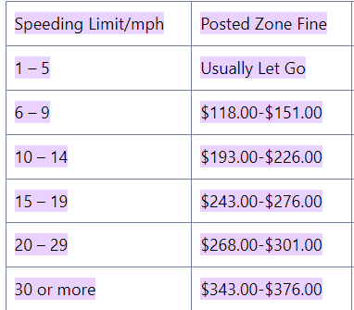
Slow Down and Stop at Stop Signs

Slide 32
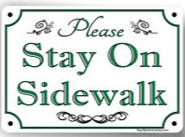
Parking Rules and Safe Walking

Slide 33
DO NOT FEED THE ALLIGATORS!

Slide 34
All Property Rentals must go through the Management Company, have the proper forms filled out and approved by your Neighborhood Association’s Board.
The MINIMUM property rental is 30 days.
Weekly and daily rentals are not permitted and may be subject to fines.

Slide 35
Pets in the Community
Owners are responsible for their pets at all times.
*Please see the pet rules for your Association.

Slide 37
Garage Sales are held twice a year in the Fall and Spring, permits are required by Collier County.
Dates will be announced by Email
Participating residents should park in the Community
or pool parking lots to ease street congestion.

Slide 39
LADIES BOOK CLUB: Meets in the HG Community Center, the 2nd Tuesday of the Month, at 10:00 AM
PICKLEBALL: There are two lined pickleball courts on our tennis courts. Two sets of nets are located in the storage locker on the court. For the combination for the locker, please see the Property Manager at the HG Community Center.
TENNIS: Open Tennis is held Monday, Wednesday and Friday, from 8:30 – 10:30.
WATER AEROBICS: Meets Monday, Wednesday, and Friday, at 9:00 AM, at the pool outside the Community Center.
MAHJONG: Meets in the HG Community Center, Wednesdays, at 9:30 AM.
Contact Person: Mary Ann Anthony (239) 254-9749

Slide 40
Resident’s Preparation for Hurricanes & Storms
**Check National Hurricane Center Website: www.nhc.noaa.gov
Update Your Contact Information:
Homeowners and renters should make sure that the Association has their accurate phone number, address and email address.
Hurricane Shutters, Windows, Doors & Garage Doors:
Homeowners should consider installing hurricane protective devices, as authorized and approved by the Architectural Review Board. Owners are responsible for repair and replacement of windows, doors and/ or garage doors per the Association’s governing documents, an owner should consider installing Collier County approved versions of these fixtures.
Disabled Resident Assistance:
Any residents needing special assistance in the event of an evacuation, should reach out to city and/ or county entitles to sign up, IN ADVANCE, for special assistance in an emergency.

Slide 41
Homeowner’s Insurance:
All homeowners should consider homeowners insurance (generally called a HO-6 policy) for their home. Florida Statutes Chapter 718.111(11)(f), in the event of a casualty to the Association property, homeowners are responsible for repairing or replacing the following items:
All personal property Floor, wall and ceiling coverings
Electrical Fixtures Appliances
Water heaters Water filters
Built-in cabinets and countertops
Window treatments including curtains, drapes, blinds, hardware
**Note: Please check your CAM and sub-association for a full list of items.

Slide 42
Photograph Your Home and Valuables:
It is worthwhile for every resident to photograph their home to capture on film all of the personal property within their home. After a storm, this can be a helpful way to identify items that are missing.
For owners with homeowner’s insurance, photographing the property (and valuable items in particular such as TVs) may make processing claims with their insurance companies much easier.
It is prudent to contact your insurance company and ask them what they would ideally like to see in the event of a major claim post hurricane. They can typically provide guidance on how to properly prepare.

Slide 43
Create a Survival Kit:
Keep a survival kit in your home that you can grab in the event of an evacuation. A survival kit should include, at a minimum:
Several days of a fresh water supply
Batteries, and a battery-operated radio
Canned goods and a manual can opener
Proper identification, important documentation (e.g., birth certificates, social security cards, insurance policies), proof of ownership of your home (possibly necessary to get back onto the property after a severe storm where major damage was sustained)
Cash, (loss of electricity means credit cards cannot be used)
All medications refilled and placed in water-tight bag
Change of clothing
Blankets

Slide 44
Local Emergency Contact in Collier County, Florida:
American Red Cross (Local Chapter) (239) 278-3401
Arson Alert Hotline (800)-342-5869, (800) 342-5869
Collier County Animal Services (239) 252-7387
Collier County Bureau of Emergency Services
(239) 252-3600
Collier County EMS (239) 252-3740 or 911
Collier County Government Center (239) 252-8999
Collier County Sheriff’s Office (239) 774-4434, 911

Slide 45
Local Emergency Contact in Collier County, Florida:
Florida Division of Emergency Management (850) 413-9969
Federal Emergency Management Agency (FEMA)
(800) 621-3362, (800) 462-7585
Florida Health Department - Collier County
(239) 389-5050, (239) 252-7300
Greater Naples Fire Rescue District (239) 348-7540, 911
Immokalee Fire Control District (239) 657-2111, 911
National Weather Service/Tampa Bay, (813) 645-2323

Slide 46
Local Emergency Contact in Collier County, Florida:
NCH Community Blood Center (239) 624-4120
Naples Police Department (239) 213-4844, 911
North Collier Fire Control and Rescue District (239) 597-3222, 911
Poison Information (800) 222-1222
Salvation Army (239) 210-4009, (239) 657-2199
State Department of Financial Services (Insurance)
(239) 461-4001 (800) 22-STORM
Traffic Conditions in Florida (Current) 511

Slide 47
If you are aware of any changes that need to be made to this program, please contact the Heritage Greens Property Manager at the HG Community Center, during posted office hours.

